Slide 1
BREAST CANCER PREDICTION
USING FNAC TEST DATA
SUPERVISED BY A Presentation by
V.DILIP KUMAR S. Sri Sai Seersha
Shaik Rizwan Ahmed
P. Vamsi Kamal
M.Prasana Kumar

Slide 2
Abstract
Breast cancer is the most common type of cancer and the second leading cause of cancer deaths in women.
Three predictive foci are related to cancer prognosis: the prediction of cancer susceptibility (risk assessment); the prediction of cancer recurrence; and the prediction of cancer survivability.
Breast cancer can be distinguished of three types: benign breast tumors, in situ cancers, and invasive cancers.

Slide 3
Introduction
The dataset is collected using FNAC test.
It is a test performed by collection of cells and doing analysis on various components of the cells collected.
We apply 6 different supervised learning algorithms on the three datasets in order to train them with the algorithm that gives out best and realistic results

Slide 4
Existing System
Most of the existing systems used different data mining techniques in the process of the prediction.
Most of the existing systems concentrated only on one area of prediction.

Slide 5
Proposed System
In the proposed system, we focus on breast cancer diagnosis, its recurrence and survivability of the patient.
The outcomes of the system are predicted by training the system with past information.
The proposed system will be able to analyze and predict outcomes effectively and this helps in early and easy detection of breast cancer.

Slide 6
Problem Statement
This system helps to diagnose breast cancer and also helps to predict whether there is a chance for its recurrence or not as well as survivability of the patient based on the given conditions.

Slide 7
Advantages
The proposed system provides an interface for 3 types of predictions: breast cancer susceptibility, breast cancer recurrence and survivability of the patient.
The proposed system helps users to easily diagnose the breast cancer and get effective required treatment.
The proposed system reduces the physical strain for users in diagnosing breast cancer and helps them to consult doctor for treatment.

Slide 8
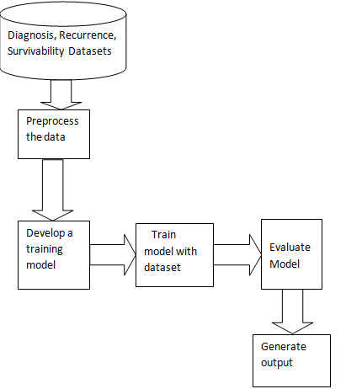
System Architecture

Slide 9
UML Diagrams : Usecase diagram

Slide 10
Class diagram

Slide 11
Sequence diagram

Slide 12
State diagram

Slide 13
Activity diagram

Slide 14
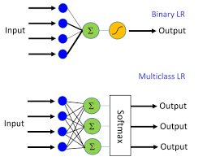
Machine Learning Techniques
LOGISTIC REGRESSION

Slide 15
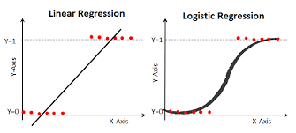
LOGISTIC REGRESSION

Slide 16
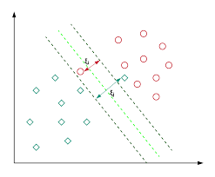
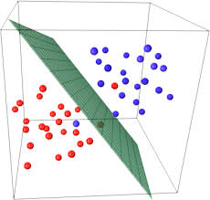
SUPPORT VECTOR MACHINE

Slide 17
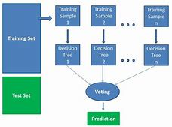
RANDOM FOREST CLASSIFIER

Slide 18
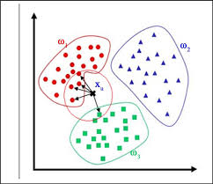
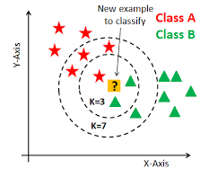
K NEAREST NEIGHBOR

Slide 19
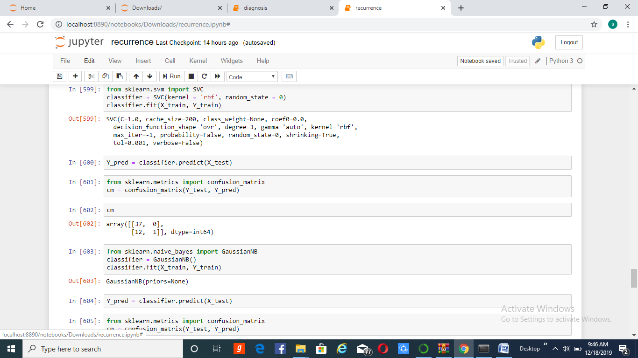
Implementation

Slide 20
from sklearn.svm import SVC
classifier = SVC(kernel = 'rbf', random_state = 0)
classifier.fit(X_train, Y_train)
Y_pred = classifier.predict(X_test)

Slide 21
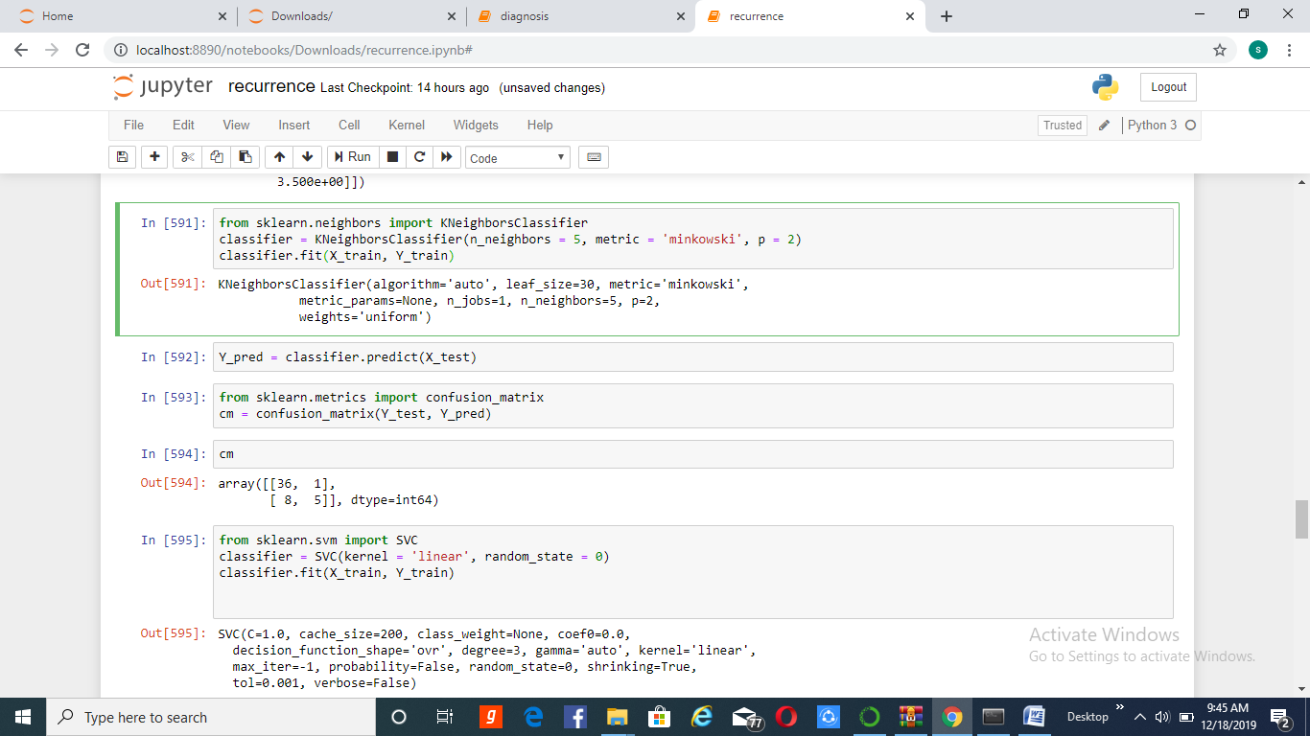

Slide 22
from sklearn.neighbors import KNeighborsClassifier
classifier = KNeighborsClassifier(n_neighbors = 5, metric = 'minkowski', p = 2)
classifier.fit(X_train, Y_train)
Y_pred = classifier.predict(X_test)

Slide 23
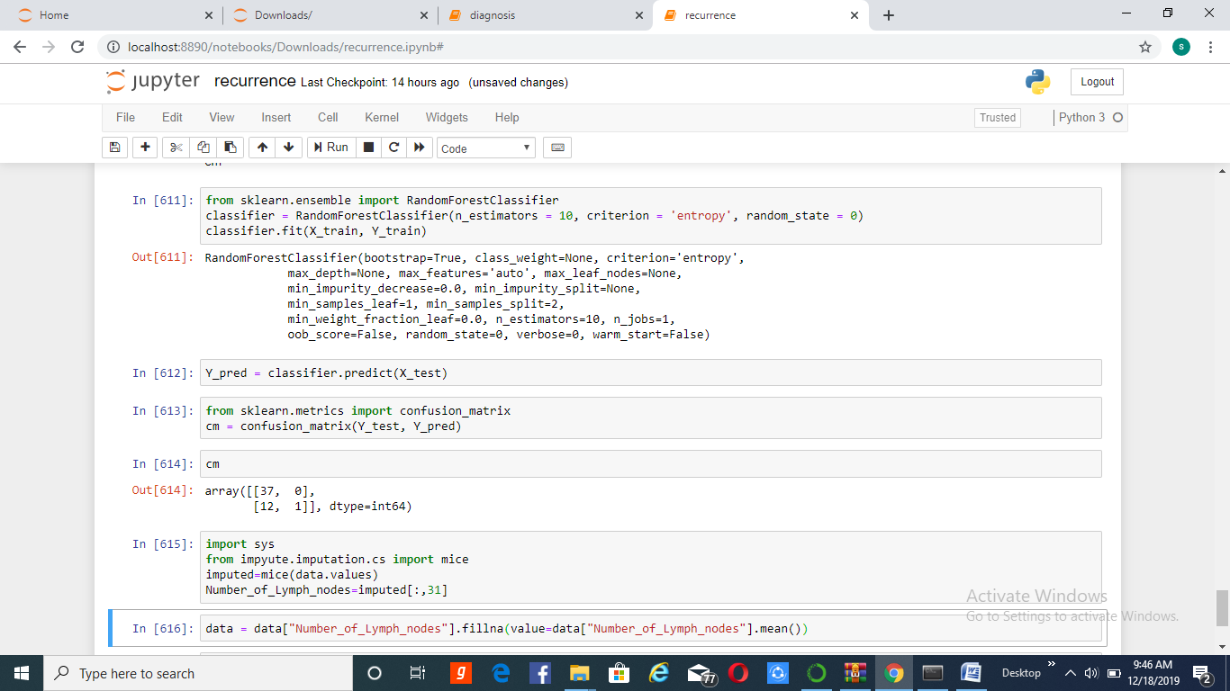

Slide 24
from sklearn.ensemble import RandomForestClassifier
classifier = RandomForestClassifier(n_estimators = 10, criterion = 'entropy', random_state = 0)
classifier.fit(X_train, Y_train)
Y_pred = classifier.predict(X_test)

Slide 25
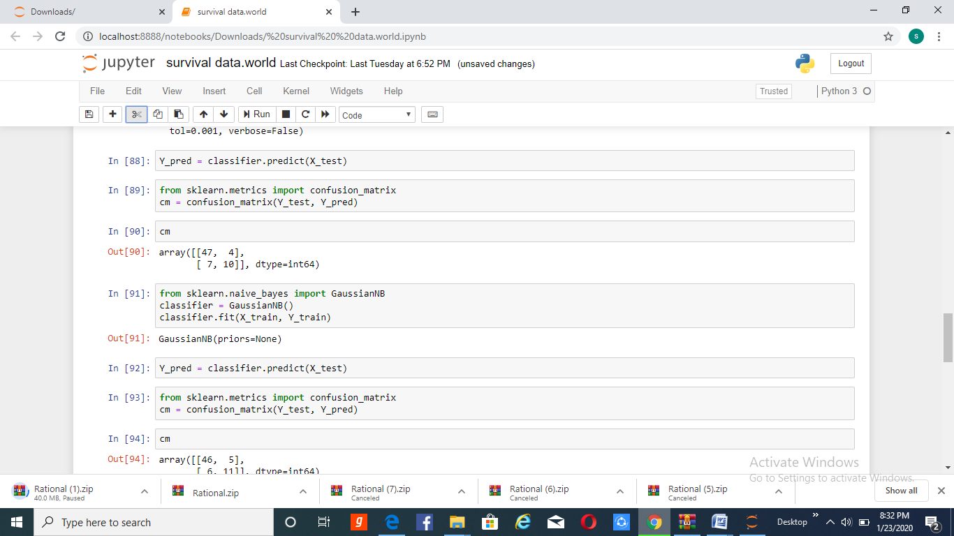

Slide 26
from sklearn.naive_bayes import GaussianNB
classifier = GaussianNB()
classifier.fit(X_train, Y_train)
Y_pred = classifier.predict(X_test)

Slide 27
Conclusion
Breast cancer is the most common cancer among women. It also occurs in men. So early detection is necessary.
This helps users for early and easy diagnosis of breast cancer so that the users can receive accurate and effective treatment based on their diagnosis.
This system is easy to understand, easy to use and provide comfortable interface for users.

Slide 28


